Slide 1
Capstone Engagement
Assessment, Analysis, and Hardening of a Vulnerable System

Slide 2
Table of Contents
This document contains the following sections:
01
Network Topology
02
Red Team: Security Assessment
03
Blue Team: Log Analysis and Attack Characterization
Hardening: Proposed Alarms and Mitigation Strategies
04

Slide 3
Network Topology
‹#›

Slide 4
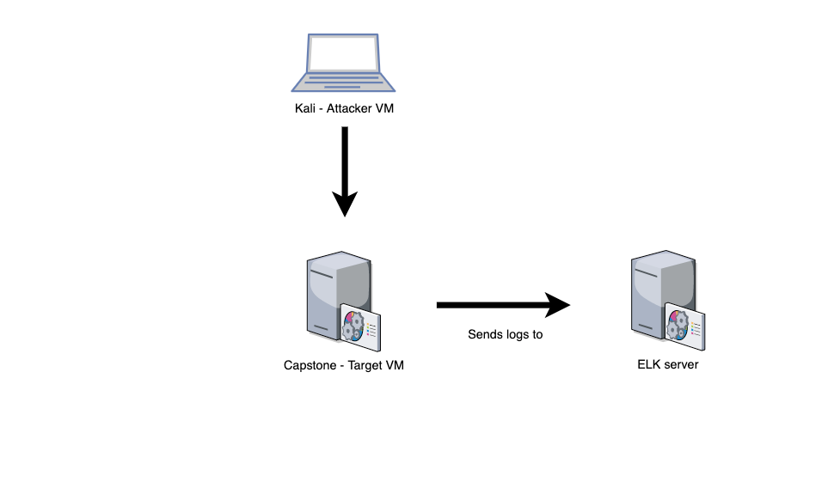
Network Topology
[Insert Here]
Use draw.io to create a diagram of the network.
Add your diagram to this slide and fill out the data in the sidebar.
Network
IP Range: 192.168.1.0/24
Netmask: 255.255.255.0
Gateway: 192.168.1.1
Machines
IPv4: 192.168.1.90
OS: Linux
Hostname: Kali
IPv4: 192.168.1.100
OS: Linux
Hostname: ELK
IPv4: 192.168.1.105
OS: Linux
Hostname: Capstone

Slide 5

Red Team
Security Assessment
‹#›

Slide 6
Recon: Describing the Target
Nmap identified the following hosts on the network:
Hostname | IP Address | Role on Network

Slide 7
Vulnerability Assessment
The assessment uncovered the following critical vulnerabilities in the target:
Vulnerability | Description | Impact
Use the CVE number if it exists. Otherwise, use the common name. | Describe the vulnerability. | Describe what this vulnerability allows the attacker to do.
Sensitive Data Exposure OWASP Top 10 #3 || Critical | The secret_folder is publicly accessible, but contains sensitive data intended only for authorized personnel. | The exposure compromises credentials that attackers can use to break into the web server.
Unauthorized File Upload Critical | Users are allowed to upload arbitrary files to the web server. | This vulnerability allows attackers to upload PHP scripts to the server.
Remote Code Execution via Command Injection OWASP Top 10 #1 || Critical | Attackers can use PHP scripts to execute arbitrary shell commands. | Vulnerability allows attackers to open a reverse shell to the server.s

Slide 8
Exploitation: Sensitive Data Exposure
01
02
03
Tools & Processes
nmap to scan network
dirb to map URLs
Browser to explore
Achievements
The exploit revealed a secret_folder directory.
This directory is password protected, but susceptible to brute-force.
Exploitation
The login prompt reveals that the user is ashton.
This information is used to run a brute-force attack and steal the data.

Slide 9
Exploitation: Unauthorized File Upload
01
02
03
Tools & Processes
Crack stolen credentials to connect via WebDAV
Generate custom web shell with msfconsole
Upload shell via WebDAV
Achievements
Uploading a web shell allows us to execute arbitrary shell commands on the target
Aftermath
Running arbitrary shell commands allows Meterpreter to open a full-fledged connection to the target

Slide 10
Exploitation: Remote Code Execution
01
02
03
Tools & Processes
Use Meterpreter to connect to uploaded web shell
Use shell to explore and compromise target
Achievements
Leveraging the RCE allows us to open a Meterpreter shell to the target
Once on the target, the full file system is available for exploration
Aftermath
Achieving a shell on the target allows us to display all files and capture the flag

Slide 11

Blue Team
Log Analysis and Attack Characterization
‹#›

Slide 12
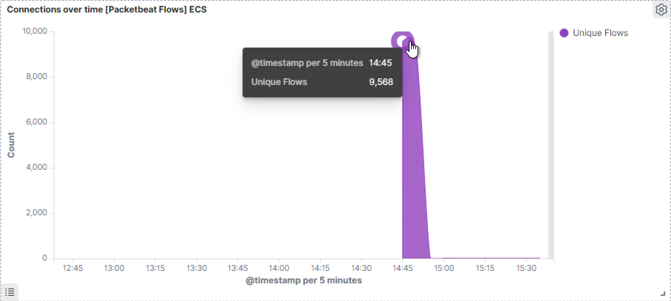
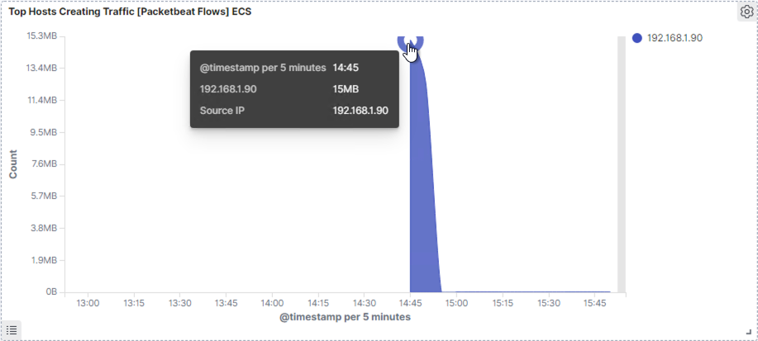
Analysis: Identifying the Port Scan
What time did the port scan occur?
2:45
How groups of many packets were sent and from which IP?
Resting the courser at the top of the arc, we can observe 9,568. In the second chart we can observe it’s the IP address 192.168.1.90.
We can observe that the victim responded back with 401 (Unauthorized), 207 (Multi-Status), 200 (OK), and 404 (Not found) responses.

Slide 13
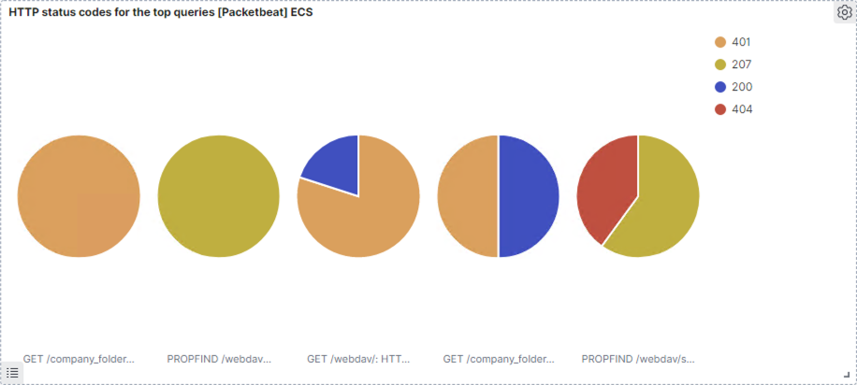
Analysis: Identifying the Port Scan (cont.)
What responses did the victim respond back with?
Notes:
What time did the request occur? How many requests were made? In the first screenshot we can observe that the attack started at 2:45 with 9,568 requests.
Which files were requested? What did they contain?
The top three hits for directories and files that were requested were
http://192.168.1.105/company_folder/secret_folder
http://192.168.1.105/company_folder/webdav
http://192.168.1.105/webdav/shell.php

Slide 14
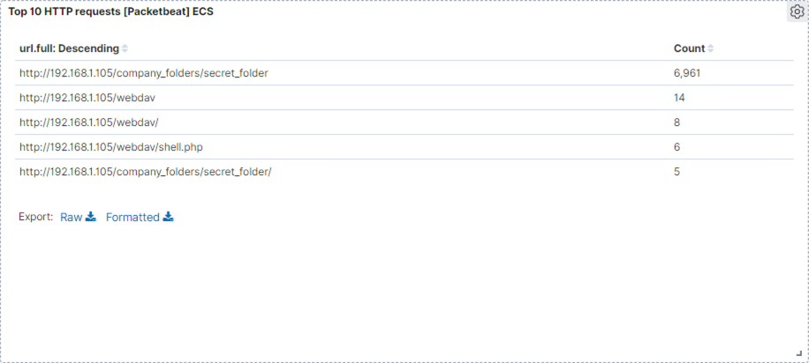
Analysis: Finding the Request for the Hidden Directory
What time did the request occur? How many requests were made?
In the first screenshot we can observe that the attack started at 2:45 with 9,568 requests.
Which files were requested? What did they contain? The top three hits for directories and files that were requested were:
http://192.168.1.105/company_folder/secret_folder
http://192.168.1.105/company_folder/webdav
http://192.168.1.105/webdav/shell.php

Slide 15
Analysis: Finding the WebDAV Connection
The secret_folder directory was requested 6,961 times.
The shell.php file was requested 6 times.

Slide 16
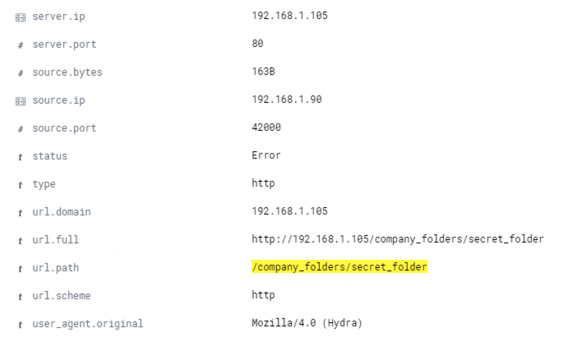
Analysis: Uncovering the Brute Force Attack
The logs contain evidence of a large number of requests for the sensitive data. Only 5 requests were successful. This is a telltale signature of a brute-force attack.
Specifically, the password protected secret_folder was requested 6961 times, but the file inside that directory was only requested 5 times. Out of 6209 requests, only 5 were successful.
Notes:
Note: The image on the right hand side is an example of hydra failing to access the contents of the secret_folder directory.

Slide 17
Blue Team
Proposed Alarms and Mitigation Strategies
‹#›

Slide 18
Mitigation: Blocking the Port Scan
What kind of alarm can be set to detect future port scans?
# of Requests per Second
What threshold would you set to activate this alarm?
Alarms should fire if a given IP address sends more than 10 requests per second for more than 5 seconds
What configurations can be set on the host to mitigate port scans?
The local firewall can be used to throttle incoming connections
ICMP traffic can be filtered
An IP allowed list can be enabled

Slide 19
Mitigation: Finding the Request for the Hidden Directory
What kind of alarm can be set to detect future unauthorized access?
Allow authorized IP addresses
Trip alarm if an IP not on the allow list attempts to connect
What threshold would you set to activate this alarm?
This is a binary alarm: If the incoming IP is not allowed, it fires. Otherwise, it does not.
What configuration can be set on the host to block unwanted access?
Access to the sensitive file can be locally restricted to a specific user.
This way, someone who gets a shell as, e.g., www-data will not be able to read it.
In addition, the file should be encrypted at rest.

Slide 20
Mitigation: Preventing Brute Force Attacks
What kind of alarm can be set to detect future brute force attacks?
# of Requests per Second
What threshold would you set to activate this alarm?
More than 100 requests per second for 5 seconds should trigger the alarm
What configuration can be set on the host to block brute force attacks?
Configuring fail2ban or a similar utility would mitigate brute force attacks

Slide 21
Mitigation: Detecting the WebDAV Connection
What kind of alarm can be set to detect future access to this directory?
Monitor access to webdav with Filebeat
Fire an alarm on any read performed on files within webdav
What threshold would you set to activate this alarm?
Simply fire the alarm whenever someone accesses the webdav directory.
Ideally, allow valid IP addresses.
What configuration can be set on the host to control access?
Administrators must install and configure Filebeat on the host.

Slide 22
Mitigation: Identifying Reverse Shell Uploads
What kind of alarm can be set to detect future file uploads?
Alarms should fire upon receipt of any POST request containing form or file data of a disallowed file type, e.g., .php.
What threshold would you set to activate this alarm?
The alarm should fire whenever users upload a forbidden file.
What configuration can be set on the host to block file uploads?
Write permissions can be restricted on the host.
Uploads can be isolated into a dedicated storage partition.
Filebeat should be enabled and configured.

